Slide 1
K-Hit Query:
Top-k Query with Probabilistic Utility Function
P. Peng and R. C. Wong. k-hit query: Top-k query with probabilistic utility function. In SIGMOD, pages 577–592, 2015.

Slide 2
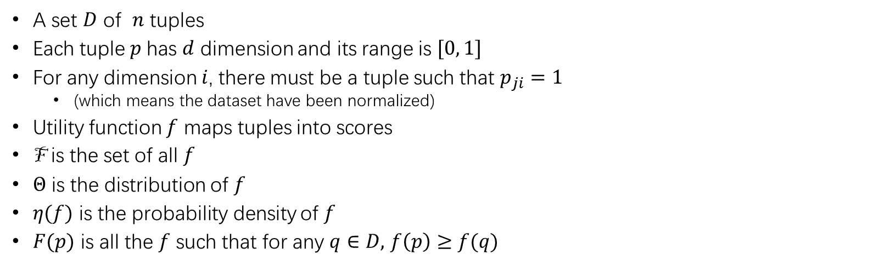

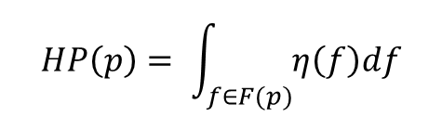
Problem Definition
A set $D$ of $n$ tuples
Each tuple $p$has $d$ dimension and its range is $[0, 1]$
For any dimension $i$, there must be a tuple such that $p_{ji}=1$
(which means the dataset have been normalized)
Utility function $f$ maps tuples into scores
F is the set of all $f$
$Θ$ is the distribution of $f$
$η(f)$ is the probability density of $f$
$F(p)$ is all the $f$ such that for any $q∈D,$ $f\left(p\right)≥f(q)$
$k−HIT QUERY:$ Given a positive integer $k$, we want to find a subset $S$ of $D$ containing $k$ tuples such that hit probability $HP\left(S\right)$ is the greatest.
$$HP\left(p\right)= \int_{f∈F(p)}{η\left(f\right)df}$$
$$HP\left(S\right)=Σ_{p∈S}HP(p)$$

Slide 3
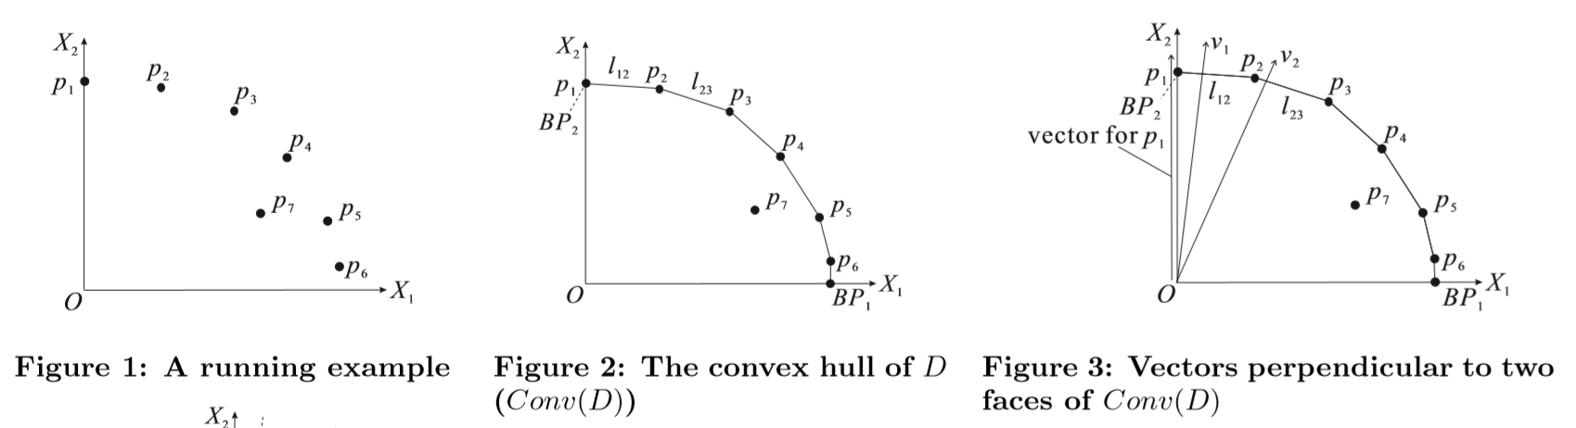


When $Θ$ is uniform and $f$ is linear vector
$F(p)$ is all the $f$ such that for any $q∈D,$ $f\left(p\right)≥f\left(q\right)$
Dominate: p dominates q if for any $i$ $p_{i}≥q_{i}$ and there exists a j such that $p_{j}>q_{i}$
The answer is in the non-dominated point set P
If $\left|P\right|<k$ just return $P∪\{any other k−\left|P\right| tuples\}$ because of $HP\left(P\right)=1$
$k−HIT QUERY:$ Given a positive integer $k$, we want to find a subset $S$ of $D$ containing $k$ tuples such that hit probability $HP\left(S\right)$ is the greatest

Slide 4
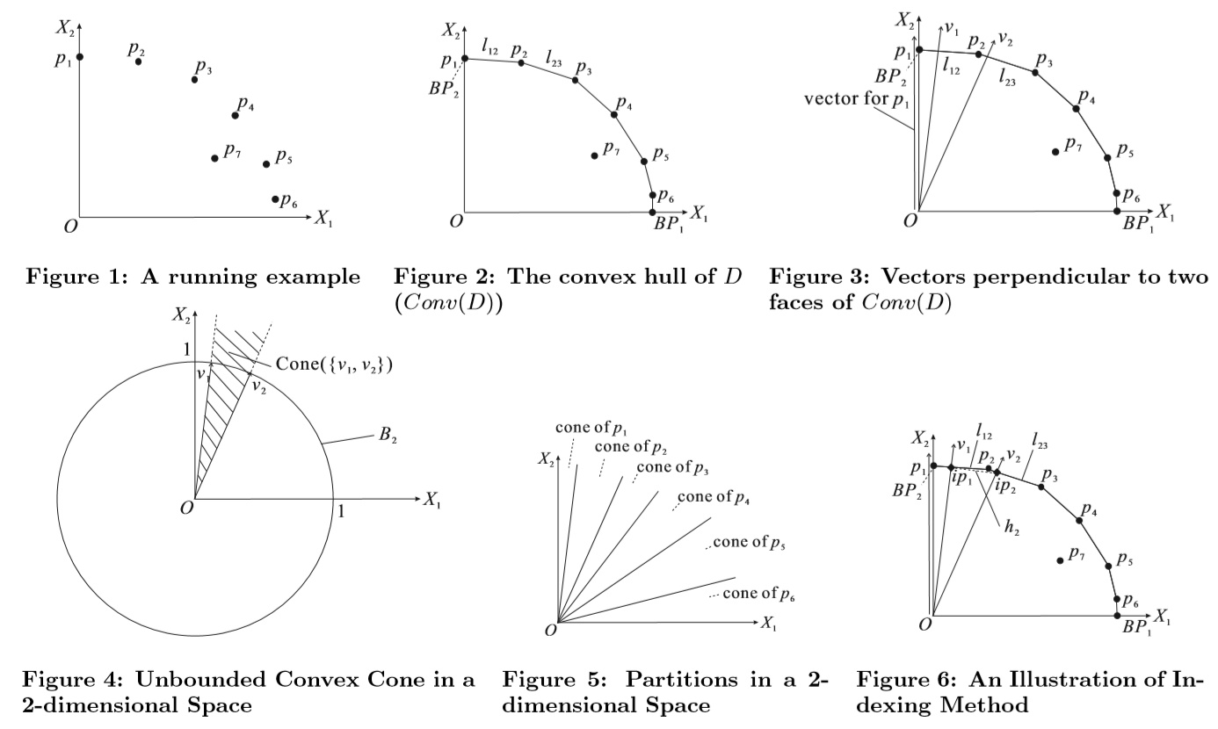
When $Θ$ is uniform, $f$ is linear vector and $\left|f\right|=1$

Slide 5
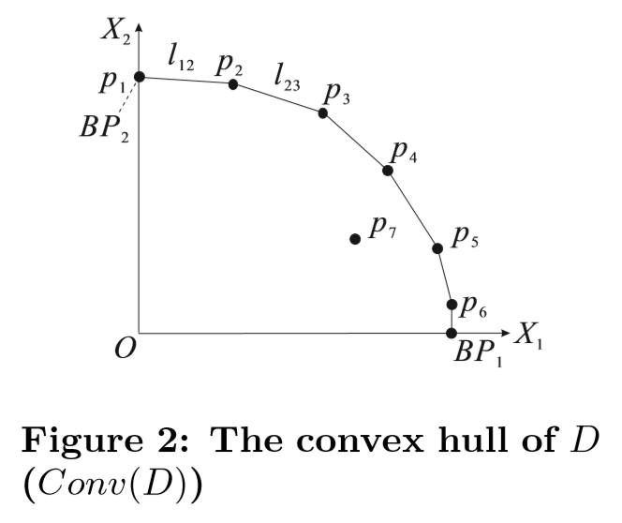
When $Θ$ is uniform, $f$ is linear vector and $\left|f\right|=1$
k-Hit_Alg:
Step 1: find all non-dominated solutions

Slide 6
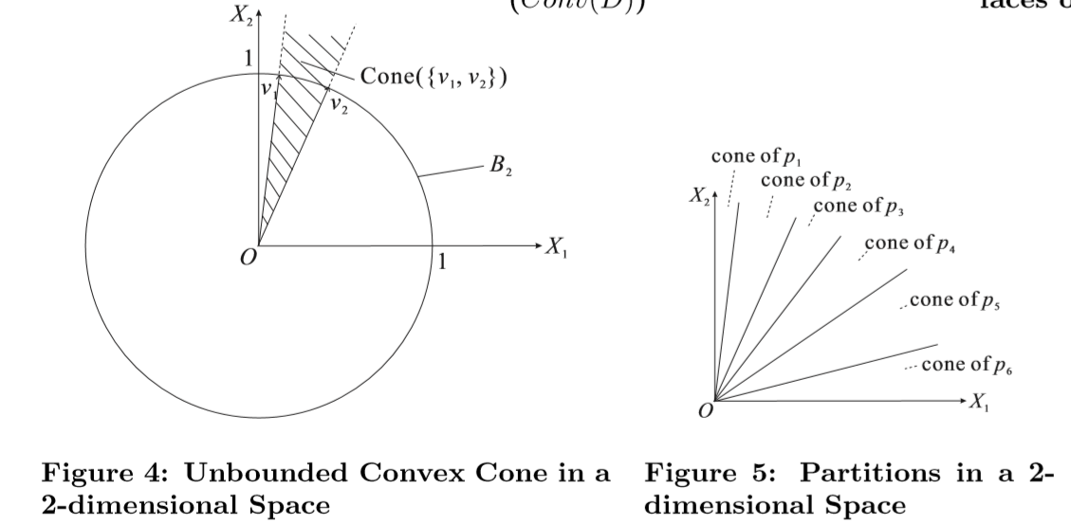

When $Θ$ is uniform, $f$ is linear vector and $\left|f\right|=1$
k-Hit_Alg:
Step 1: find all non-dominated solutions
Step 2: compute $HP(p)$ for each p that we found in step 1
Step 3: find the top-k tuples with greatest $HP$

Slide 7
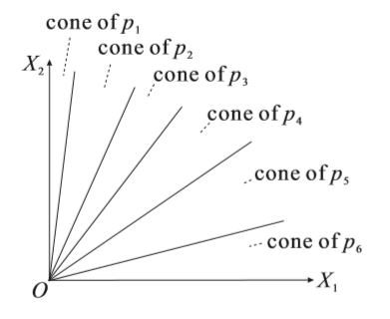
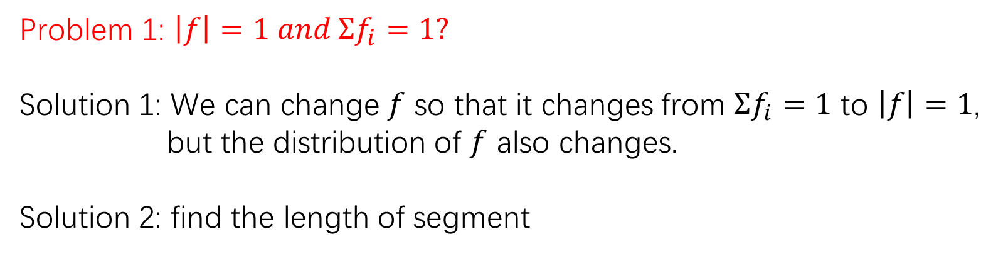

When $Θ$ is uniform, $f$ is linear vector and $\left|f\right|=1$
Problem 1: $\left|f\right|=1 and Σf_{i}=1?$
Solution 1: We can change $f$ so that it changes from $Σf_{i}=1$ to $\left|f\right|=1$,
but the distribution of $f$ also changes.
Solution 2: find the length of segment
$$X_{1}+X_{2}=1$$

Slide 8
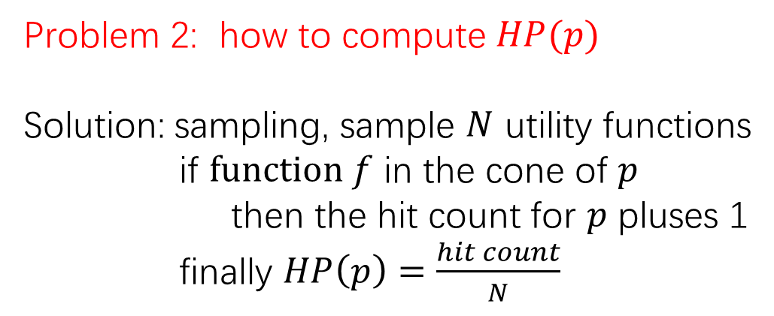

When $Θ$ is uniform, $f$ is linear vector and $\left|f\right|=1$
k-Hit_Alg:
Step 1: find all non-dominated solutions
Step 2: compute HP(p) for each p that we found in step 1
Step 3: find the top-k $p$ with greatest $HP(p)$
Problem 2: how to compute $HP(p)$
Solution: sampling, sample $N$ utility functions
if $function f$ in the cone of $p$
then the hit count for $p$ pluses 1
finally $HP\left(p\right)=\frac{hit count}{N}$

Slide 9
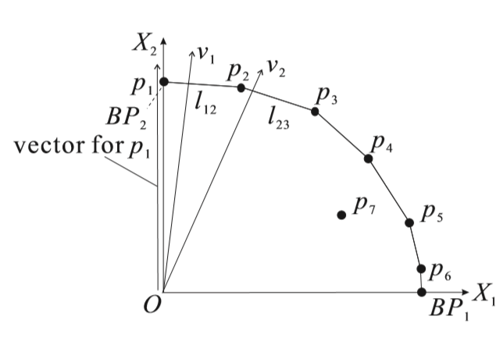
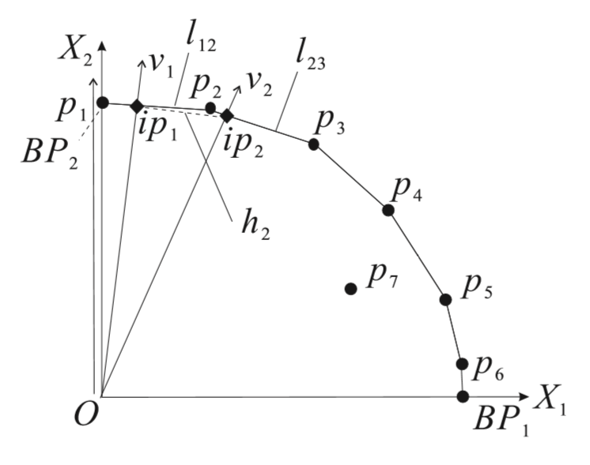
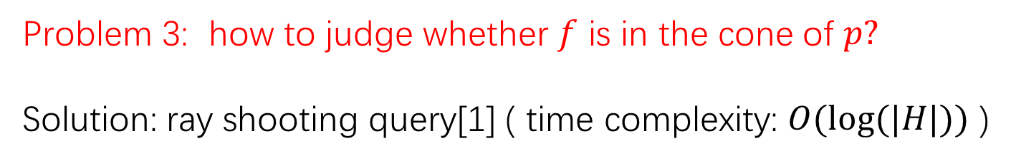
When $Θ$ is uniform, $f$ is linear vector and $\left|f\right|=1$
Problem 3: how to judge whether $f$ is in the cone of $p?$
Solution: ray shooting query[1] ( time complexity: $O(log⁡(|H|))$ )
[1] P. K. Agarwal and J. Matouˇsek. Ray shooting and parametric search. SIAM Journal on Computing, 22(4):794–806, 1993.

Slide 10
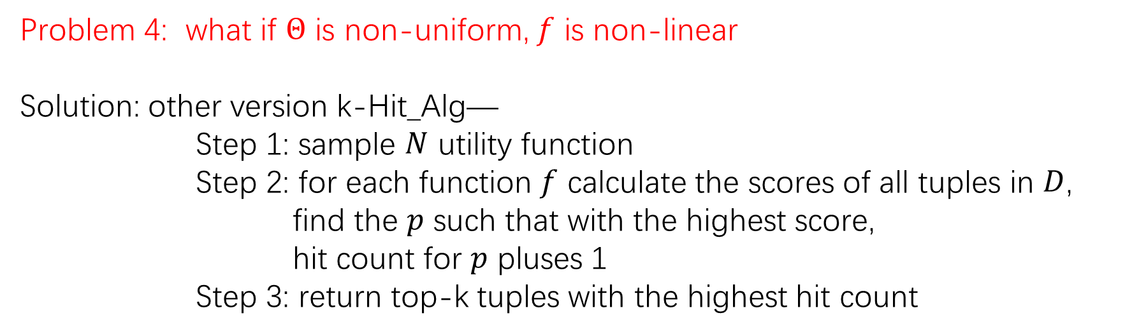

When $Θ$ is uniform, $f$ is linear vector and $\left|f\right|=1$
k-Hit_Alg:
Step 1: find all non-dominated solutions
Step 2: compute HP(p) for each p that we found in step 1
Step 3: find the top-k $p$ with greatest $HP(p)$
Problem 4: what if $Θ$ is non-uniform, $f$ is non-linear
Solution: other version k-Hit_Alg—
Step 1: sample $N$ utility function
Step 2: for each function $f$ calculate the scores of all tuples in $D$,
find the $p$ such that with the highest score,
hit count for $p$ pluses 1
Step 3: return top-k tuples with the highest hit count

Slide 11
Thanks

